Slide 1
STRING & JAVA COLLECTION
Instructor:

Slide 2
Table of contents
String
StringBuffer
StringBuilder
List Collection

Slide 3
Learning Approach
Strongly suggested for a better learning and understanding of this course:
Noting down the key concepts in the class
Analyze all the examples / code snippets provided
Study and understand the self study topics
Completion and submission of all the assignments, on time
Completion of the self review questions in the lab guide
Study and understand all the artifacts
Completion of the project on time inclusive of individual and group activities
Notes:
The following are strongly suggested for a better learning and understanding of this course:
Noting down the key concepts in the class
Analyze all the examples / code snippets provided
Study and understand the self study topics
Completion and submission of all the assignments, on time
Completion of the self review questions in the lab guide
Study and understand all the artifacts including the reference materials / e-learning / supplementary materials specified
Completion of the project (if application for this course) on time inclusive of individual and group activities
Taking part in the self assessment activities
Participation in the doubt clearing Sections

Slide 4
String CLASS
Section 1

Slide 5
String class
String is a sequence of characters, for e.g. “Hello” is a string of 5 characters.
In java, string is an immutable object which means it is constant and can cannot be changed once it has been created.
Creating a String
There are two ways to create a String in Java
String literal
Using new keyword

Slide 6
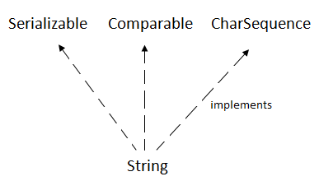
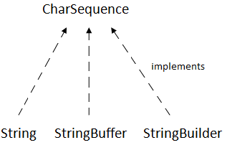
Java String
The java.lang.String class implements Serializable, Comparable and CharSequence interfaces.
The CharSequence interface is used to represent the sequence of characters. String, StringBuffer and StringBuilder classes implement it.

Slide 7
String literal
In java, Strings can be created like this: Assigning a String literal to a String instance.
Example:
String s1= “abc";
String s3= “abc";
Notes:
String pool (Heap) lưu String literal mà nếu String literal có cùng value thì cùng trỏ đến 1 ô nhớ nên tiết kiệm bộ nhớ.

Slide 8
String object
Using new keyword
The compiler would create two different object in memory having the same string.
Example:
public class StringSample {
public static void main(String[] args) {
// creating a string by java string literal
String s1 = "FPT";
String s3 = "FPT";
char arrch[] = { 'h', 'e', 'l', 'l', 'o' };
// converting char array arrch[] to string str2
String s2= new String(arrch);
// creating another java string str3 by using new keyword
String s4 = new String("hello");
// Displaying all the three strings
System.out.println(s1.equals(s3));
System.out.println(s2.equals(s4));
System.out.println(s1 == s3);
System.out.println(s2 == s4);
}
}
Output:
true
true
true
false

Slide 9
String class
Methods:
char charAt(int index): It returns the character at the specified index. Specified index value should be between 0 to length() -1 both inclusive. It throws IndexOutOfBoundsException if index<0||>= length of String.
boolean equals(Object obj): Compares the string with the specified string and returns true if both matches else false.
int compareTo(String string): This method compares the two strings based on the Unicode value of each character in the strings.
boolean startsWith(String prefix): It tests whether the string is having specified prefix, if yes then it returns true else false.
boolean endsWith(String suffix): Checks whether the string ends with the specified suffix.
int hashCode(): It returns the hash code of the string.
int indexOf(int ch): Returns the index of first occurrence of the specified character ch in the string.
boolean contains(CharSequence s): It checks whether the string contains the specified sequence of char values. If yes then it returns true else false. It throws NullPointerException of ‘s’ is null.

Slide 10
String class
Methods:
String concat(String str): Concatenates the specified string “str” at the end of the string.
String trim(): Returns the substring after omitting leading and trailing white spaces from the original string.
byte[] getBytes(): This method is similar to the above method it just uses the default charset encoding for converting the string into sequence of bytes.
int length(): It returns the length of a String.
boolean matches(String regex): It checks whether the String is matching with the specified regular expression regex.
static String valueOf(): This method returns a string representation of passed arguments such as int, long, float, double, char and char array.
char[] toCharArray(): Converts the string to a character array.
String[] split(String regex): Same as split(String regex, int limit) method however it does not have any threshold limit.

Slide 11
String/Number casting
Convert a digit sequence to number
// Each class in right hand side is called wrapper
// class of the corresponding primitive type
byte b = Byte.parseByte("128");
// NumberFormatException
short s = Short.parseShort("32767");
int x = Integer.parseInt("2");
int y = Integer.parseInt("2.5");
// NumberFormatException
int z = Integer.parseInt("a");
// NumberFormatException
long l = Long.parseLong("15");
float f = Float.parseFloat("1.1");
double d = Double.parseDouble("2.5");

Slide 12
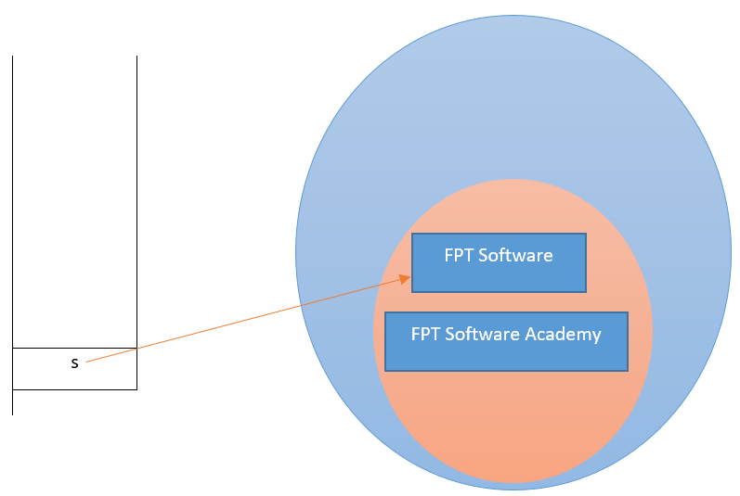
Immutable String
In java, string objects are immutable. Immutable simply means unmodifiable or unchangeable.
Example:
Output:
public class TestImmutableString {
public static void main(String[] args) {
String s = "FPT Software";
s.concat(" Academy"); // concat() method appends the string at the end
System.out.println(s);// will print FPT Software because strings are
// immutable objects
}
}
FPT Software
Solution:
s = s.concat(" Academy");

Slide 13
String Comparison
We can compare string in java on the basis of content and reference.
It is used in authentication (by equals() method), sorting (by compareTo() method), reference matching (by == operator) etc.
There are three ways to compare string in java:
In authentication: by equals()/equalsIgnoreCase() method
In sorting: by == operator
Reference matching: by compareTo() method. This method compares values lexicographically (từ vựng) and returns an integer value that describes if first string is less than, equal to or greater than second string.

Slide 14
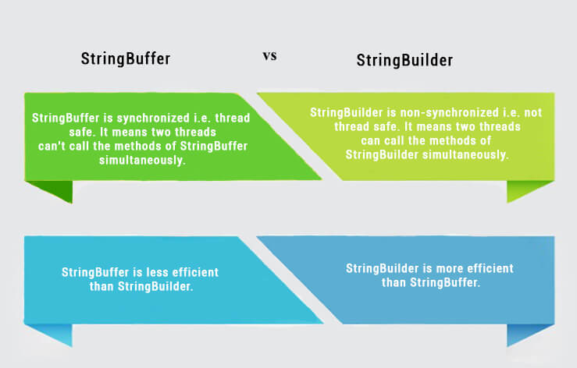
StringBuilder and StringBuffer classes
The StringBuffer and StringBuilder classes: to make a lot of modifications to Strings of characters.
The StringBuilder class was introduced as of Java 5 and the main difference between the StringBuffer and StringBuilder is that StringBuilders methods are not thread safe (not Synchronised).
It is recommended to use StringBuilder whenever possible because it is faster than StringBuffer. However if thread safety is necessary the best option is StringBuffer objects.

Slide 15
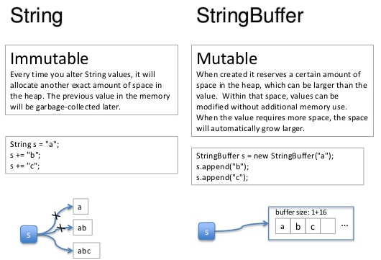
String/StringBuilder/StringBuffer
String is immutable, if you try to alter their values, another object gets created,
StringBuffer and StringBuilder are mutable so they can change their values.

Slide 16
Methods of StringBuffer class
Method | Description
public synchronized StringBuffer append(String s) | Is used to append the specified string with this string. The append() method is overloaded like: append(char), append(boolean), append(int), append(float), append(double) etc.
public synchronized StringBuffer insert(int offset, String s) | Is used to insert the specified string with this string at the specified position. The insert() method is overloaded like: insert(int, char), insert(int, boolean), insert(int, int), insert(int, float), insert(int, double) etc.
public synchronized StringBuffer replace(int startIndex, int endIndex, String str) | Is used to replace the string from specified startIndex and endIndex.
public synchronized StringBuffer delete(int startIndex, int endIndex) | Is used to delete the string from specified startIndex and endIndex.
public synchronized StringBuffer reverse() | Is used to reverse the string.

Slide 17
Methods of StringBuffer class
Method | Description
public int capacity() | Is used to return the current capacity.
public void ensureCapacity(int minimumCapacity) | Is used to ensure the capacity at least equal to the given minimum.
public char charAt(int index) | Is used to return the character at the specified position.
public int length() | Is used to return the length of the string i.e. total number of characters.
public String substring(int beginIndex) | Is used to return the substring from the specified beginIndex.
public String substring(int beginIndex, int endIndex) | Is used to return the substring from the specified beginIndex and endIndex.

Slide 18
StringBuilder class
The Java StringBuilder class is same as StringBuffer class except that it is non-synchronized.
Example:
No. | StringBuffer | StringBuilder
1) | StringBuffer is synchronized i.e. thread safe. It means two threads can't call the methods of StringBuffer simultaneously. | StringBuilder is non-synchronized i.e. not thread safe. It means two threads can call the methods of StringBuilder simultaneously.
2) | StringBuffer is less efficient than StringBuilder. | StringBuilder is more efficient than StringBuffer.
public class ConcatTest {
public static void main(String[] args) {
long startTime = System.currentTimeMillis();
StringBuffer sb = new StringBuffer("Java");
for (int i = 0; i < 1000000; i++) {
sb.append(" Learning");
}
System.out.println("Time taken by StringBuffer: "
+ (System.currentTimeMillis() - startTime) + "ms");
startTime = System.currentTimeMillis();
StringBuilder sb2 = new StringBuilder("Java");
for (int i = 0; i < 1000000; i++) {
sb2.append(" Learning");
}
System.out.println("Time taken by StringBuilder: "
+ (System.currentTimeMillis() - startTime) + "ms");
}
}
Output:
Time taken by StringBuffer: 51ms
Time taken by StringBuilder: 26ms

Slide 19
StringBuilder/StringBuffer examples
StringBuilder sb = new StringBuilder("abc");
sb.append(" def"); // "abc def“
char letter = str.charAt(2); // “b“
char ch[] = new char[3];
str.getChars(1,3,ch,0); // Bây giờ biến “ch” chứa “abc”
sb.delete(3, 5); // "abcef"
sb.deleteCharAt(4); // "abce"
sb.insert(3, " d"); // "abc de"
sb.replace(2, 4, " ghi"); // "ab ghide"
sb.reverse(); // "edihg ba"
sb.setCharAt(5, 'j'); // "edihgjba"

Slide 20
Using StringTokenizer Class
StringTokenizer can be used to parse a line into words
import java.util.*
some of its useful methods are shown in the text
e.g. test if there are more tokens
you can specify delimiters (the character or characters that separate words)
the default delimiters are "white space" (space, tab, and newline)

Slide 21
Example: StringTokenizer
Display the words separated by any of the following characters: space, new line (\n), period (.) or comma (,).
String inputLine = keyboard.nextLine();
StringTokenizer wordFinder =
new StringTokenizer(inputLine, " \n.,");
//the second argument is a string of the 4delimiters
while(wordFinder.hasMoreTokens())
{
System.out.println(wordFinder.nextToken());
}
Question 2b or !tooBee
Entering "Question,2b.or !tooBee." gives this output:

Slide 22
Java collections
Section 2

Slide 23
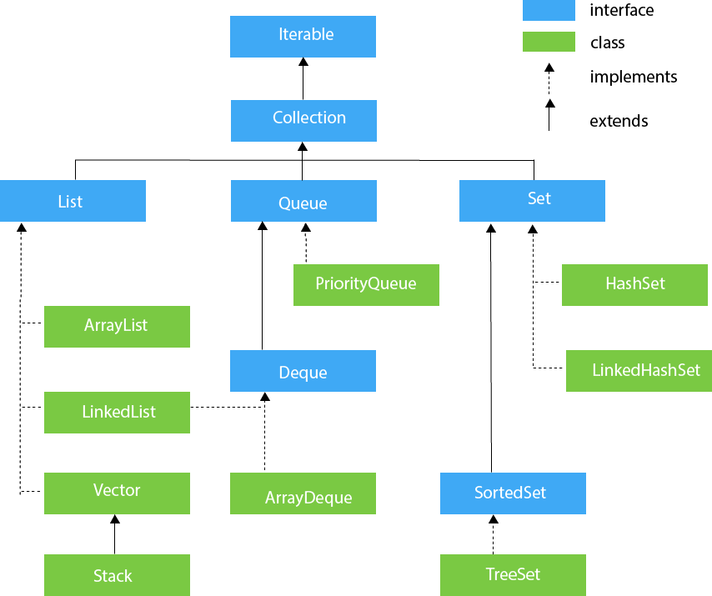
Overview
The Collection in Java is a framework that provides an architecture to store and manipulate the group of objects.
Java Collections can achieve all the operations that you perform on a data such as searching, sorting, insertion, manipulation, and deletion.
Java Collection means a single unit of objects. Java Collection framework provides many interfaces (Set, List, Queue, Deque) and classes (ArrayList, Vector, LinkedList, PriorityQueue, HashSet, LinkedHashSet, TreeSet).
Refs: https://www.javatpoint.com/

Slide 24
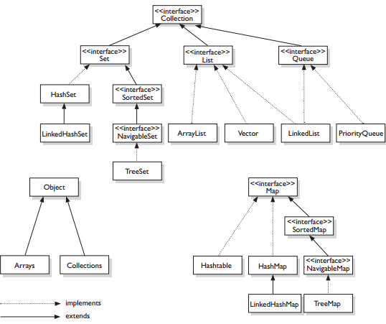
Overview

Slide 25
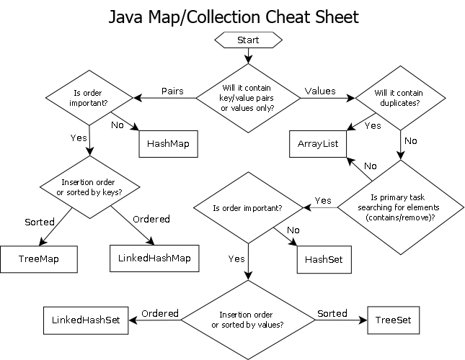
Java Collection Cheat Sheet
Collection Interface

Slide 26
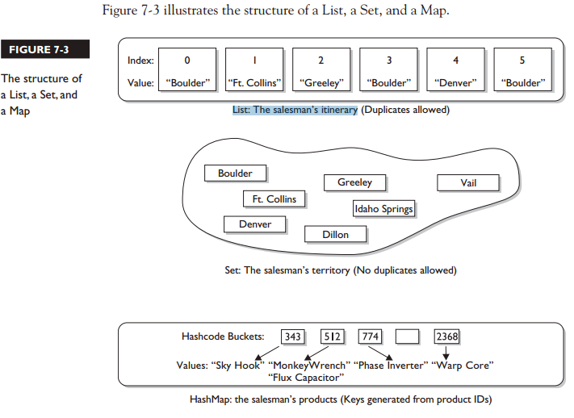
Java Collection

Slide 27
List collection
Section 3

Slide 28
List Interface
List interface is the child interface of Collection interface.
List interface is implemented by the classes ArrayList, LinkedList, Vector, and Stack.
To instantiate the List interface, we must use:
There are various methods in List interface that can be used to insert, delete, and access the elements from the list.
List <data-type> list1= new ArrayList();
List <data-type> list2 = new LinkedList();
List <data-type> list3 = new Vector();
List <data-type> list4 = new Stack();

Slide 29
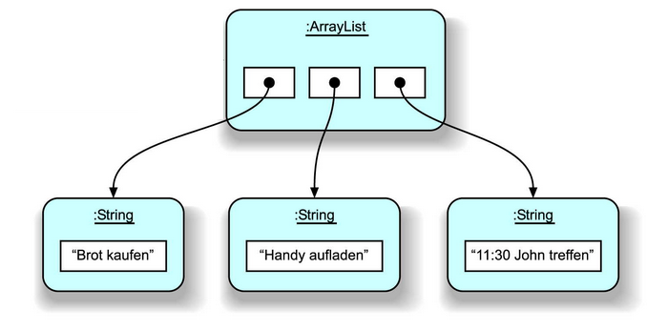
ArrayList
ArrayList supports dynamic arrays that can grow as needed.
Array lists are created with an initial size.
When this size is exceeded, the collection is automatically enlarged.
When objects are removed, the array may be shrunk
Syntax:
List<DataType> arrName = new ArrayList<>();
Notes:
https://www.javatpoint.com/java-arraylist

Slide 30
ArrayList
ArrayList is implemented as a resizable array. The important points about Java ArrayList class are:
Java ArrayList class can contain duplicate elements.
Java ArrayList class maintains insertion order.
Java ArrayList class is non synchronized.
Java ArrayList allows random access because array works at the index basis. The elements in an ArrayList can be accessed directly and efficiently by using the get() and set() methods.
In ArrayList, manipulation is little bit slower than the LinkedList in Java because a lot of shifting needs to occur if any element is removed from the array list.
ArrayList class declaration:
public class ArrayList<E> extends AbstractList<E>
implements List<E>, RandomAccess, Cloneable, Serializable
Notes:
ArrayList Vs LinkedList
1) Search: ArrayList search operation is pretty fast compared to the LinkedList search operation. get(int index) in ArrayList gives the performance of O(1) while LinkedList performance is O(n).
Reason: ArrayList maintains index based system for its elements as it uses array data structure implicitly which makes it faster for searching an element in the list. On the other side LinkedList implements doubly linked list which requires the traversal through all the elements for searching an element.
2) Deletion: LinkedList remove operation gives O(1) performance while ArrayList gives variable performance: O(n) in worst case (while removing first element) and O(1) in best case (While removing last element).
Conclusion: LinkedList element deletion is faster compared to ArrayList.
Reason: LinkedList’s each element maintains two pointers (addresses) which points to the both neighbor elements in the list. Hence removal only requires change in the pointer location in the two neighbor nodes (elements) of the node which is going to be removed. While In ArrayList all the elements need to be shifted to fill out the space created by removed element.
3) Inserts Performance: LinkedList add method gives O(1) performance while ArrayList gives O(n) in worst case. Reason is same as explained for remove.
4) Memory Overhead: ArrayList maintains indexes and element data while LinkedList maintains element data and two pointers for neighbor nodes hence the memory consumption is high in LinkedList comparatively.

Slide 31
Main methods of ArrayList
Constructor | Description
ArrayList() | It is used to build an empty array list.
ArrayList(Collection<? extends E> c) | It is used to build an array list that is initialized with the elements of the collection c.
ArrayList(int capacity) | It is used to build an array list that has the specified initial capacity.
Method | Description
void add(int index, E element) | It is used to insert the specified element at the specified position in a list.
boolean add(E e) | It is used to append the specified element at the end of a list.
boolean addAll(Collection<? extends E> c) | It is used to append all of the elements in the specified collection to the end of this list, in the order that they are returned by the specified collection's iterator.
E get(int index) | It is used to fetch the element from the particular position of the list.
boolean isEmpty() | It returns true if the list is empty, otherwise false.
boolean contains(Object o) | It returns true if the list contains the specified element

Slide 32
Main methods of ArrayList
Method | Description
int indexOf(Object o) | It is used to return the index in this list of the first occurrence of the specified element, or -1 if the List does not contain this element.
E remove(int index) | It is used to remove the element present at the specified position in the list.
boolean remove(Object o) | It is used to remove the first occurrence of the specified element.
boolean removeAll(Collection<?> c) | It is used to remove all the elements from the list.
boolean removeIf(Predicate<? super E> filter) | It is used to remove all the elements from the list that satisfies the given predicate.
protected void removeRange(int fromIndex, int toIndex) | It is used to remove all the elements lies within the given range.
void retainAll(Collection<?> c) | It is used to retain all the elements in the list that are present in the specified collection.
ist<E> subList(int fromIndex, int toIndex) | It is used to fetch all the elements lies within the given range.
int size() | It is used to return the number of elements present in the list.

Slide 33
ArrayList: Input
public class ListExample {
public static void main(String[] args) {
List<Integer> list = new ArrayList<Integer>();
list.add(3); list.add(2);
list.add(1); list.add(4);
list.add(5); list.add(6);
list.add(6);
for (Integer integer : list) {
System.out.println(integer);
}
}
}

Slide 34
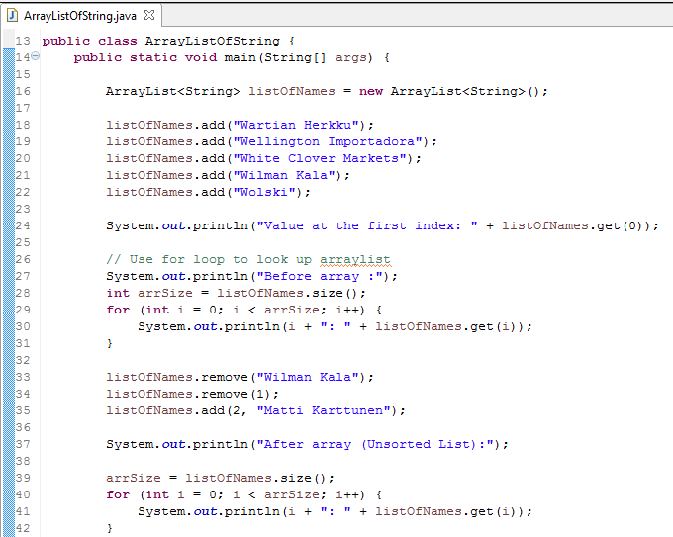
ArrayList Example
Can use ArrayList to store String, Number:
Instance of ArrayList
Add value into ArrayList
Get value from ArrayList
Using for loop to lookup value
Remove by Value
Remove by Index
Add value by Index

Slide 35
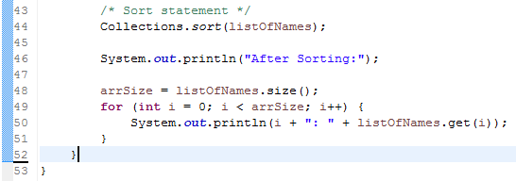
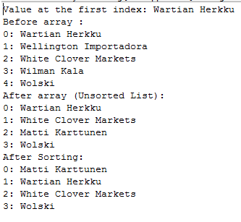
ArrayList Example
Can use ArrayList to store String, Number:
Result:
Sort statement

Slide 36
ArrayList with Object
Create an Animal class:
public class Animal {
private String name;
private float weight;
public Animal() {
}
public Animal(String name, float weight) {
super();
this.name = name;
this.weight = weight;
}
public String getName() {
return name;
}
public void setName(String name) {
this.name = name;
}
public float getWeight() {
return weight;
}
public void setWeight(float weight) {
this.weight = weight;
};
}

Slide 37
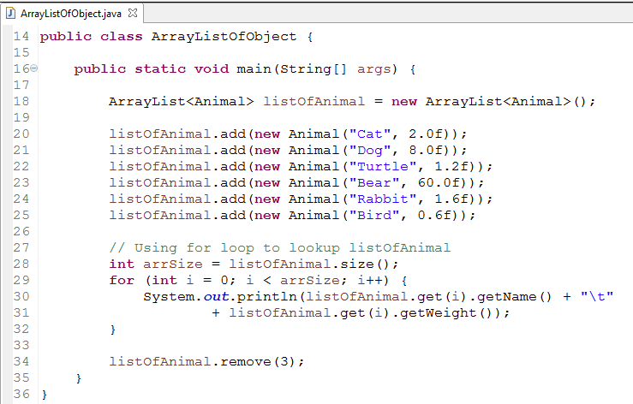
ArrayList with Object
Can use ArrayList to store Objects:
Instance of ArrayList
Add Animal to ArrayList
Use for loop to get
Remove by Index

Slide 38
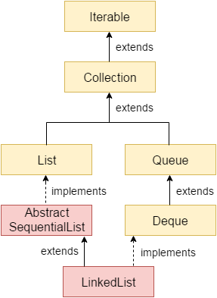
LinkedList
Java LinkedList class uses a doubly linked list to store the elements.
The important points about Java LinkedList are:
Java LinkedList class can contain duplicate elements.
Java LinkedList class maintains insertion order.
Java LinkedList class is non synchronized.
In Java LinkedList class, manipulation is fast because no shifting needs to occur.
Java LinkedList class can be used as a list, stack or queue.
Notes:
ArrayList: lưu index và value
LinkedList: lưu 1 value và 2 node (1 trỏ trước – 1 trỏ sau)
ArrayList khi xóa 1 phần tử trong mảng thì sẽ phải xếp lại thứ tự các element
LinkedList khi xóa 1 phần tử thì
ArrayList trong thực tế xài nhiều hơn LinkedList:
LinkedList lưu rất nặng bộ nhớ (bởi ngoài lưu value còn có lưu node)
ArrayList truy xuất ngẫu nhiên tốt hơn và thực tế nhu cầu truy xuất ngẫu nhiên rất cao

Slide 39

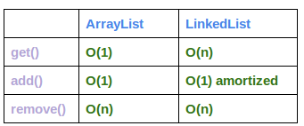
LinkedList
Doubly Linked List
Declaration:
LinkedList is implemented as a double linked list. Its performance on add() and remove() is better than the performance of Arraylist. The get() and get() methods have worse performance than the ArrayList, as theLinkedList does not provide direct access.
public class LinkedList<E> extends AbstractSequentialList<E>
implements List<E>, Deque<E>, Cloneable, Serializable
Notes:
ArrayList Vs LinkedList
1) Search: ArrayList search operation is pretty fast compared to the LinkedList search operation. get(int index) in ArrayList gives the performance of O(1) while LinkedList performance is O(n).
Reason: ArrayList maintains index based system for its elements as it uses array data structure implicitly which makes it faster for searching an element in the list. On the other side LinkedList implements doubly linked list which requires the traversal through all the elements for searching an element.
2) Deletion: LinkedList remove operation gives O(1) performance while ArrayList gives variable performance: O(n) in worst case (while removing first element) and O(1) in best case (While removing last element).
Conclusion: LinkedList element deletion is faster compared to ArrayList.
Reason: LinkedList’s each element maintains two pointers (addresses) which points to the both neighbor elements in the list. Hence removal only requires change in the pointer location in the two neighbor nodes (elements) of the node which is going to be removed. While In ArrayList all the elements need to be shifted to fill out the space created by removed element.
3) Inserts Performance: LinkedList add method gives O(1) performance while ArrayList gives O(n) in worst case. Reason is same as explained for remove.
4) Memory Overhead: ArrayList maintains indexes and element data while LinkedList maintains element data and two pointers for neighbor nodes hence the memory consumption is high in LinkedList comparatively.

Slide 40
Main methods of LinkedList
Method | Description
void addFirst(E e) | It is used to insert the given element at the beginning of a list.
void addLast(E e) | It is used to append the given element to the end of a list.
E get(int index) | It is used to return the element at the specified position in a list.
E getFirst() | It is used to return the first element in a list.
E getLast() | It is used to return the last element in a list.
E peek() | It retrieves the first element of a list
E peekFirst() | It retrieves the first element of a list or returns null if a list is empty.
E peekLast() | It retrieves the last element of a list or returns null if a list is empty.
E poll() | It retrieves and removes the first element of a list.

Slide 41
Main methods of LinkedList
Method | Description
E poll() | It retrieves and removes the first element of a list.
E pollFirst() | It retrieves and removes the first element of a list, or returns null if a list is empty.
E pollLast() | It retrieves and removes the last element of a list, or returns null if a list is empty.
E pop() | It pops an element from the stack represented by a list.
void push(E e) | It pushes an element onto the stack represented by a list.
E removeFirst() | It removes and returns the first element from a list.
E removeLast() | It removes and returns the last element from a list.

Slide 42
LinkedList Example
public class TestLinkedList {
public static void main(String args[]) {
LinkedList<String> ll = new LinkedList<String>();
System.out.println("Initial list of elements: " + ll);
ll.add("Java");
ll.add("Net");
ll.add("Android");
System.out.println("After invoking add(E e) method: " + ll);
// Adding an element at the specific position
ll.add(1, "iOs");
System.out
.println("After invoking add(int index, E element) method: " + ll);
LinkedList<String> ll2 = new LinkedList<String>();
ll2.add("Test");
ll2.add("Automation Test");
// Adding second list elements to the first list
ll.addAll(ll2);
System.out.println(
"After invoking addAll(Collection<? extends E> c) method: " + ll);
// Adding an element at the first position
ll.addFirst("C++");
System.out.println("After invoking addFirst(E e) method: " + ll);
// Adding an element at the last position
ll.addLast("Kotlin");
System.out.println("After invoking addLast(E e) method: " + ll);
ll.removeFirst();
System.out.println("After invoking removeFirst() method: " + ll);
ll.removeLast();
System.out.println("After invoking removeLast() method: " + ll);
}
}
Output:
Initial list of elements: []
After invoking add(E e) method: [Java, Net, Android]
After invoking add(int index, E element) method: [Java, iOs, Net, Android]
After invoking addAll(Collection<? extends E> c) method: [Java, iOs, Net, Android, Test, Automation Test]
After invoking addFirst(E e) method: [C++, Java, iOs, Net, Android, Test, Automation Test]
After invoking addLast(E e) method: [C++, Java, iOs, Net, Android, Test, Automation Test, Kotlin]

Slide 43
Difference between ArrayList and LinkedList
ArrayList | LinkedList
1. ArrayList internally uses a dynamic array to store the elements. | LinkedList internally uses a doubly linked list to store the elements.
2. Manipulation with ArrayList is slow because it internally uses an array. If any element is removed from the array, all the bits are shifted in memory. | Manipulation with LinkedList is faster than ArrayList because it uses a doubly linked list, so no bit shifting is required in memory.
3. An ArrayList class can act as a list only because it implements List only. | LinkedList class can act as a list and queue both because it implements List and Deque interfaces.
4. ArrayList is better for storing and accessing data. | LinkedList is better for manipulating data.

Slide 44
Summary
String
StringBuffer
StringBuilder
List Collection

Slide 45

Thank you
45

